Slide 1
M. Tech (CSE) – Second Semester (Term: June - Sep 2022) Quantum computing[MSC22] NON- CIE COMPONENT Title : Quantum Circuits
Ramaiah Institute of Technology
Department of Computer Science and Engineering
Presented By:
Anusha Bai R
1MS21SCS03

Slide 2
Quantum circuits
Like mathematics, computer science will be somewhat different from the other
sciences, in that it deals with artificial laws that can be proved, instead of
natural laws that are never known with certainty.
– Donald Knuth

Slide 3
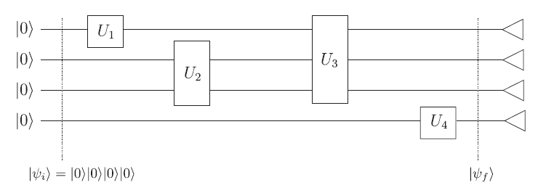
In the quantum circuit model, we have logical qubits carried along ‘wires’, and quantum gates that act on the qubits. A quantum gate acting on n qubits has the input qubits carried to it by n wires, and n other wires carry the output qubits away from the gate.
In this fig: A quantum circuit. The 4-qubit state |0|0|0|0 enters the circuit on the left. The boxes labelled U1, U2, U3, U4 represent quantum gates applied to the qubits (in the order indicated from left to right). The joint (possibly entangled) 4-qubit state after the gates are applied is |ψf . The small triangles at the right side of the circuit indicate that each of the four qubits of the final state are measured in the computational basis to provide the output of the circuit.

Slide 4
Quantum algorithms
The spectacular promise of quantum computers is to enable new algorithms which render feasible problems requiring exorbitant resources for their solution on a classical computer. two broad classes of quantum algorithms are known which fulfill this promise.
The first class of algorithms is based upon Shor’s quantum Fourier transform, and includes remarkable algorithms for solving the factoring and discrete logarithm problems, providing a striking exponential speedup over the best known classical algorithms.
The second class of algorithms is based upon Grover’s algorithm for performing quantum searching. These provide a less striking but still remarkable quadratic speedup over the best possible classical algorithms.

Slide 5
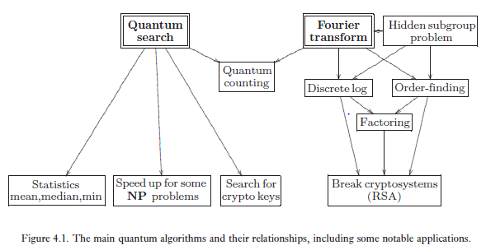

Slide 6


Single qubit operations
A single qubit is a vector |ψ = a|0 + b|1 parameterized by two complex numbers satisfying
|a|2 + |b|2 = 1. Operations on a qubit must preserve this norm, and thus are described by 2×2
unitary matrices. Of these, some of the most important are the Pauli matrices
Three other quantum gates will play a large part in what follows, the Hadamard gate (denoted H), phase gate (denoted S), and π/8 gate (denoted T):

Slide 7
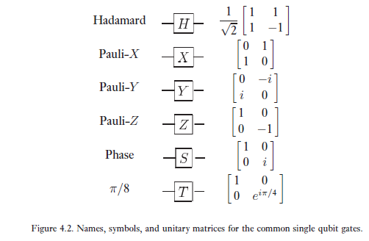
some common single qubit gates

Slide 8
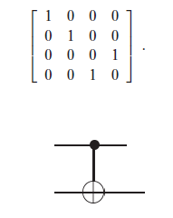
Controlled operations
The prototypical controlled operation is the controlled-NOT, which we’ll often refer to as CNOT is a quantum gate with two input qubits, known as the control qubit and target qubit
the action of the is given by |c|t → |c|t ⊕ c; that is, if the control qubit is set to |1 then the target qubit is flipped, otherwise the target qubit is left alone.
Figure . Circuit representation for the controlled- NOT gate. The top line represents the control qubit, the
bottom line the target qubit.

Slide 9
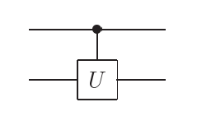
More generally, suppose U is an arbitrary single qubit unitary operation. A controlled-U operation is a two qubit operation, again with a control and a target qubit. If the control qubit is set then U is applied to the target qubit, otherwise the target qubit is left alone; that is, |c|t → |cUc|t. The controlled-U operation is represented by the circuit shown in Figure
FIG: Controlled-U operation. The top line is the control qubit, and the bottom line is the target qubit. If the
control qubit is set then U is applied to the target, otherwise it is left alone.

Slide 10
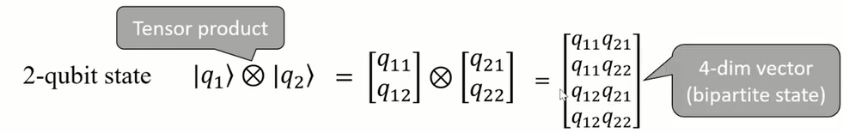
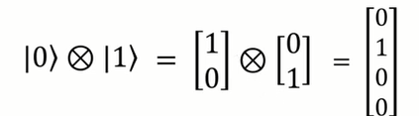


Multiple qubits and multipartite quantum states
Scale up states space by combining single qubits with n qubits, we represent 2n, states(vectors)
4 possible state with 2 qubits: {|00>,|01>,|10>,|11>

Slide 12
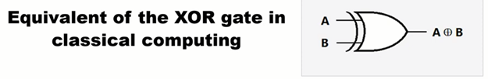
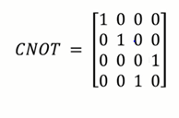
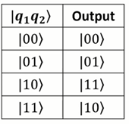
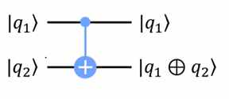



Slide 13
QISKIT
A quantum circuit is a computational routine consisting of coherent quantum operations on quantum data, such as qubits, and concurrent real-time classical computation. It is an ordered sequence of quantum gates, measurements and resets, all of which may be conditioned on and use data from the real-time classical computation.
A set of quantum gates is said to be universal if any unitary transformation of the quantum data can be efficiently approximated arbitrarily well as a sequence of gates in the set. Any quantum program can be represented by a sequence of quantum circuits and non-concurrent classical computation.

Slide 14
Quantum gates
Second, we apply a sequence of quantum gates that manipulate the three qubits as required by the teleportation algorithm. In this case, we only need to apply single-qubit Hadamard (HH) and two-qubit Controlled-X (⊕⊕) gates.
Measurements
Third, we measure two of the three qubits. A classical computer interprets the measurements of each qubit as classical outcomes (0 and 1) and stores them in the two classical bits.
Classically conditioned quantum gates
Fourth, we apply single-qubit ZZ and XX quantum gates on the third qubit. These gates are conditioned on the results of the measurements that are stored in the two classical bits. In this case, we are using the results of the classical computation concurrently in real-time within the same quantum circuit.

Slide 15
Circuit Basics
Qiskit provides the basic building blocks necessary to program quantum computers. The fundamental unit of Qiskit is the quantum circuit. A basic workflow using Qiskit consists of two stages: Build and Run. Build allows you to make different quantum circuits that represent the problem you are solving, and Run that allows you to run them on different backends. After the jobs have been run, the data is collected and postprocessed depending on the desired output.
import numpy as np
from qiskit import QuantumCircuit
Building the circuit
The basic element needed for your first program is the QuantumCircuit. We begin by creating a QuantumCircuit comprised of three qubits.
circ = QuantumCircuit(3)

Slide 16

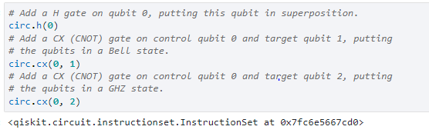
After you create the circuit with its registers, you can add gates (“operations”) to manipulate the registers. below is an example of a quantum circuit that makes a three-qubit GHZ state
To create such a state, we start with a three-qubit quantum register. By default, each qubit in the register is initialized to |0⟩ To make the GHZ state, we apply the following gates: - A Hadamard gate H on qubit 0, which puts it into the superposition state (|0⟩+|1⟩)/2. - A Controlled-NOT operation (CX) between qubit 0 and qubit 1. - A Controlled-NOT operation between qubit 0 and qubit 2. In Qiskit, operations can be added to the circuit one by one, as shown below

Slide 17
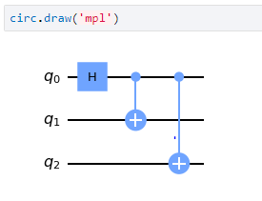
Visualize Circuit
You can visualize your circuit using Qiskit QuantumCircuit.draw(), which plots the circuit in the form
In this circuit, the qubits are put in order, with qubit zero at the top and qubit two at the bottom. The circuit is read left to right

Slide 18
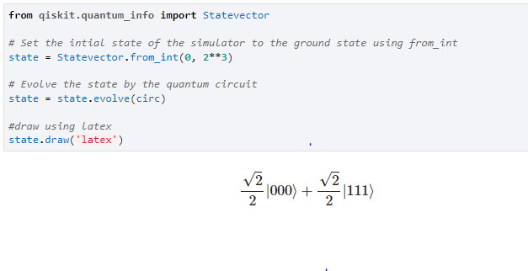
Simulating circuits
To simulate a circuit we use the quant_info module in Qiskit. This simulator returns the quantum state, which is a complex vector of dimensions 2n, where n is the number of qubits (so be careful using this as it will quickly get too large to run on your machine).
There are two stages to the simulator. The first is to set the input state and the second to evolve the state by the quantum circuit.

Slide 19
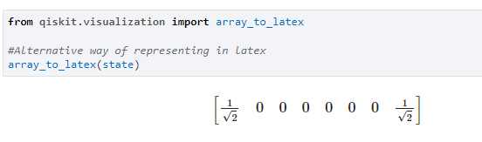
Qiskit also provides a visualization toolbox to allow you to view the state.
Below, we use the visualization function to plot the qsphere and a hinton representing the real and imaginary components of the state density matrix ρ.

Slide 20
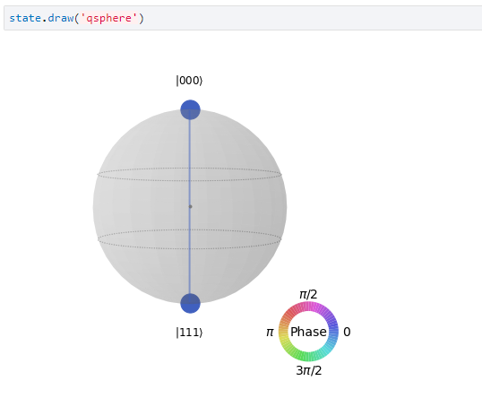

Slide 21
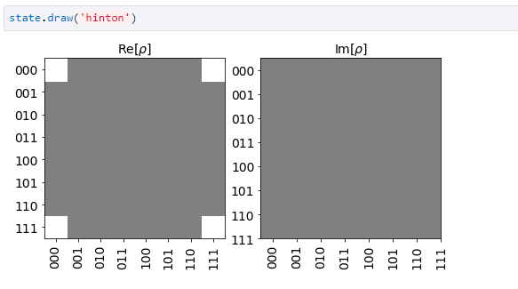

Slide 22
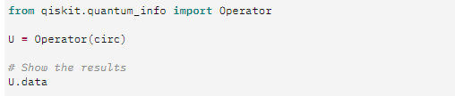
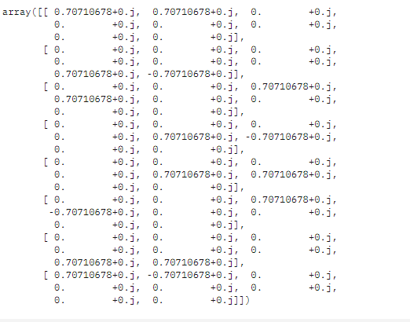

Slide 23
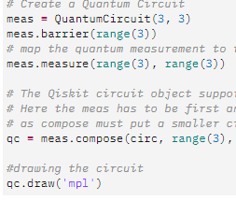
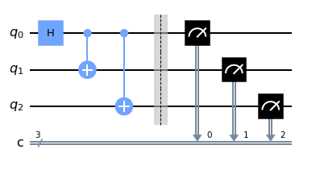

Slide 24
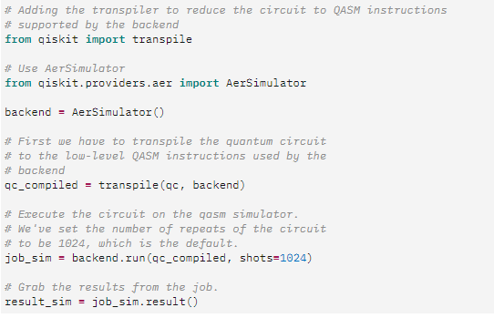


Slide 25

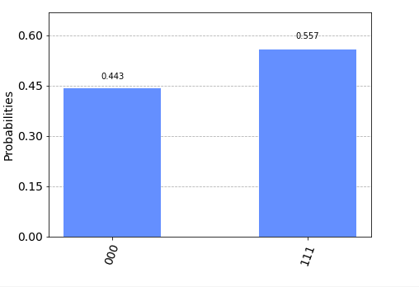

Slide 26
Thank you

